Slide 1
Network Addressing
Networking for Home and Small Businesses – Chapter 5

Slide 2
Objectives
Describe the purpose of an IP address and Subnet Mask and how they are used on the Internet.
Describe the types of IP Addresses available.
Describe the methods of obtaining an IP Address.
Describe the use of NAT on a home or small business network using an Integrated Router.

Slide 3
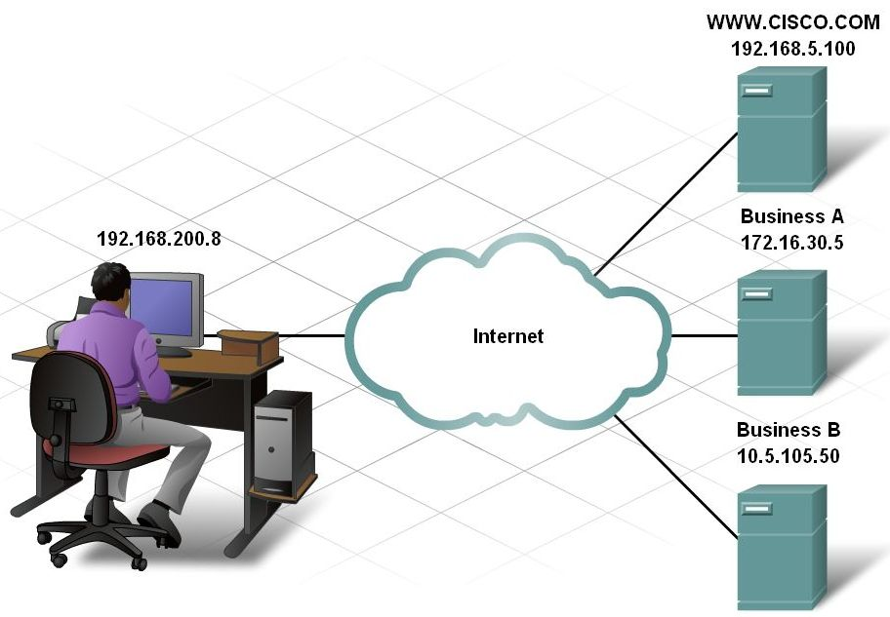
Purpose of an IP Address and Subnet Mask
Review the purpose of the IP address

Slide 4
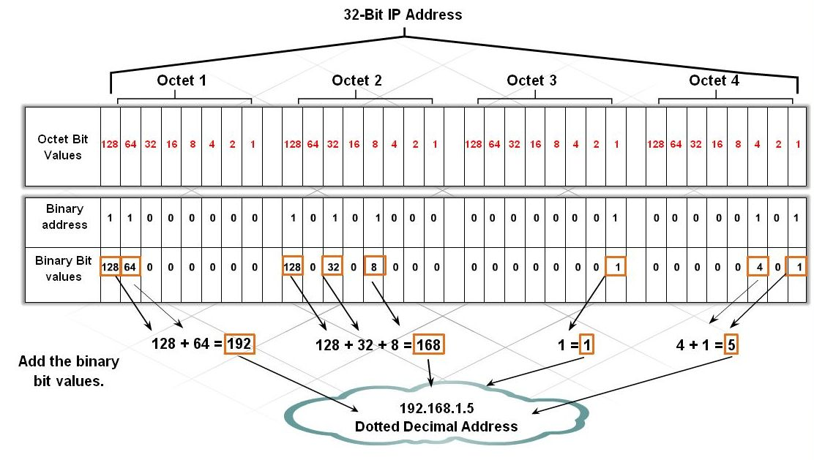
Purpose of an IP Address and Subnet Mask
Describe the structure of an IP address

Slide 5
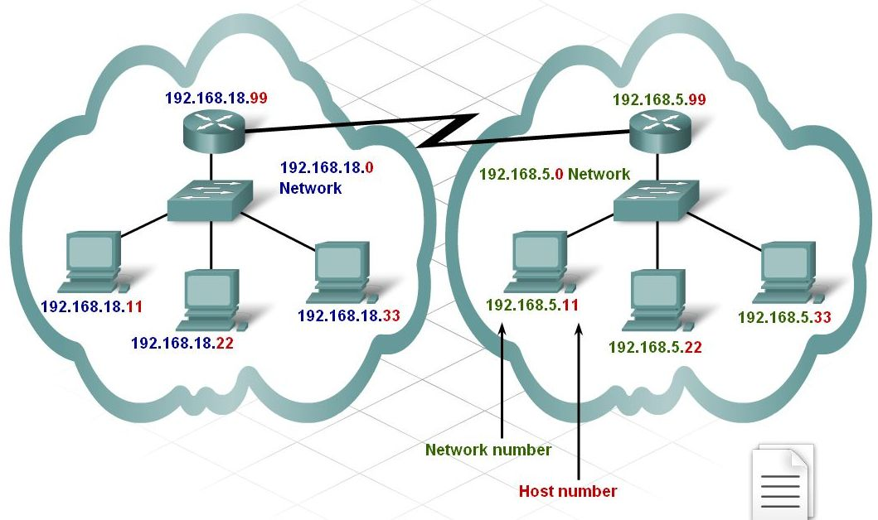
Purpose of an IP Address and Subnet Mask
Identify and describe the parts of the IP address and their purpose

Slide 6
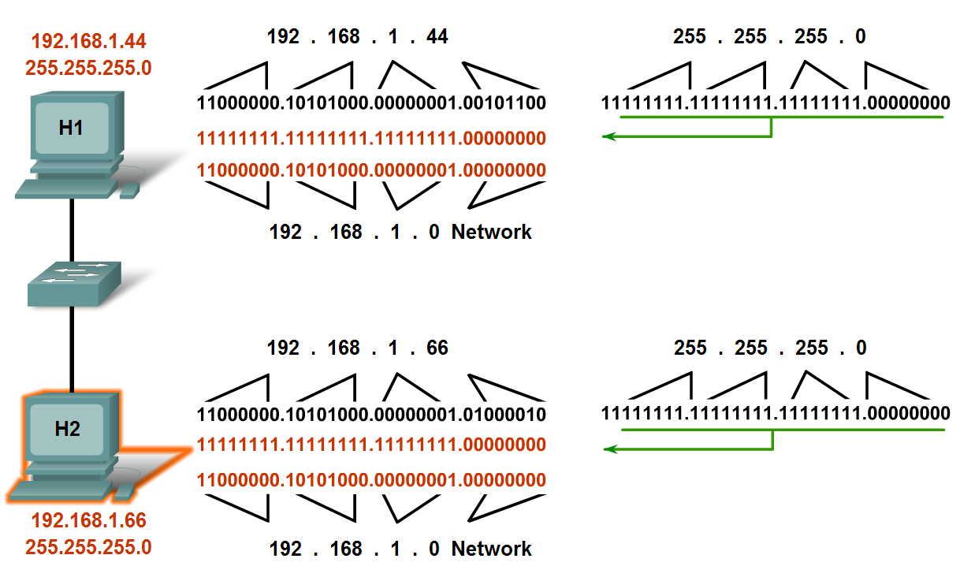
Purpose of an IP Address and Subnet Mask
Describe a subnet mask and its purpose

Slide 7
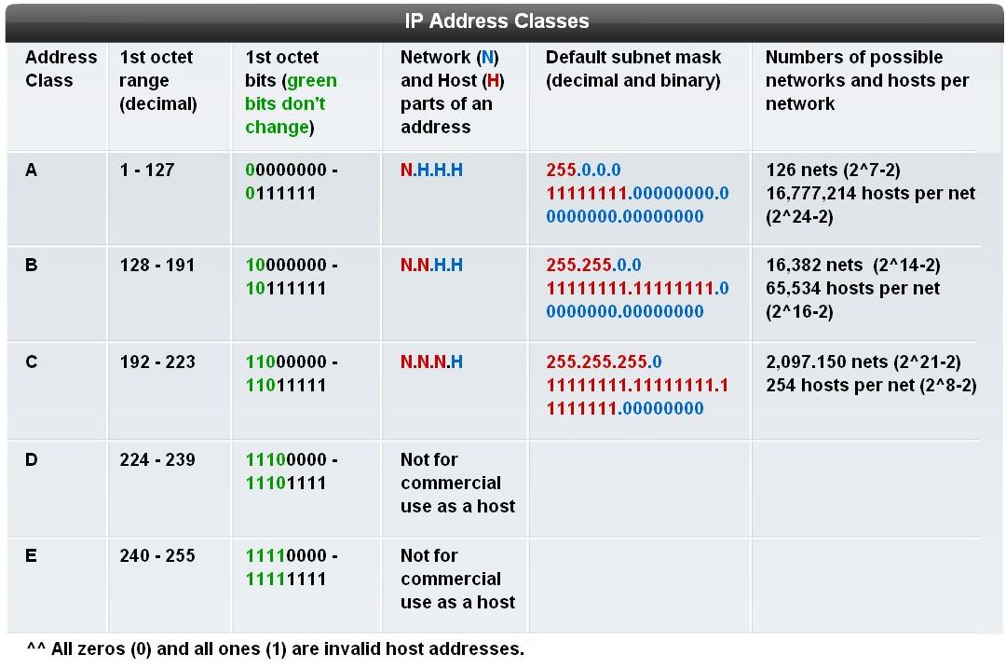
Types of IP Addresses
Describe the classes of IP address and the default subnet mask

Slide 8
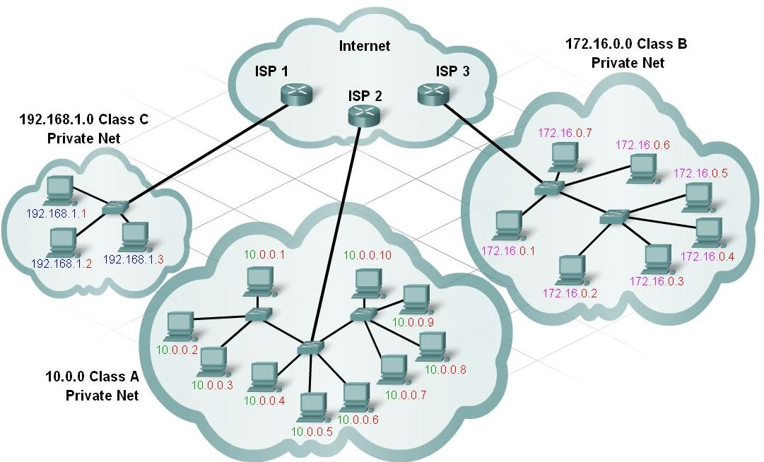
Types of IP Addresses
Describe private and public addressing and when each is used

Slide 9
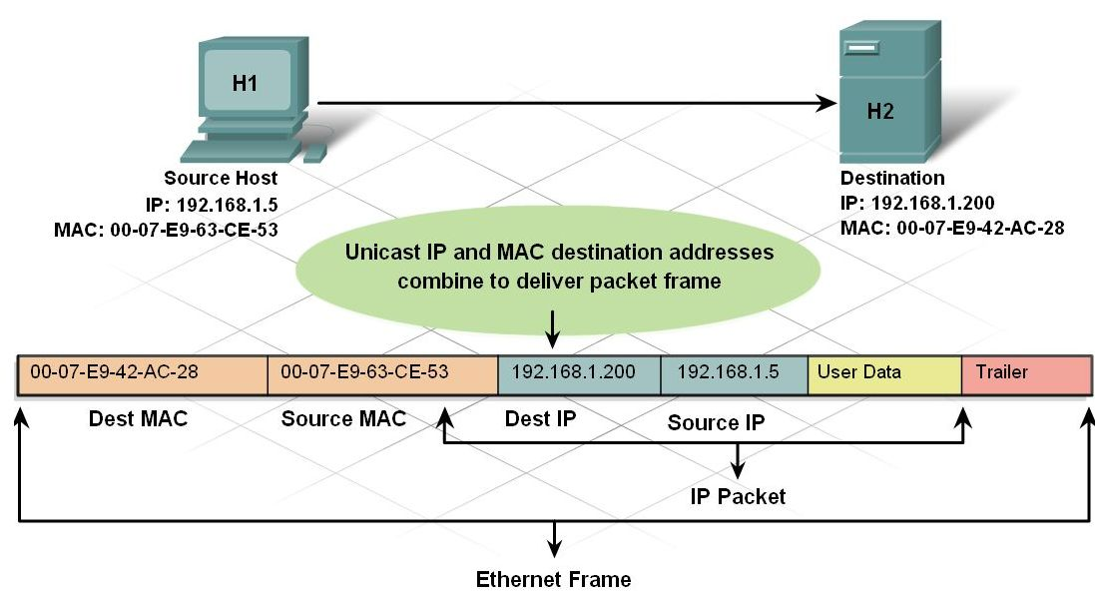
Types of IP Addresses
Differentiate between Unicast, Broadcast, Multicast Addresses

Slide 10
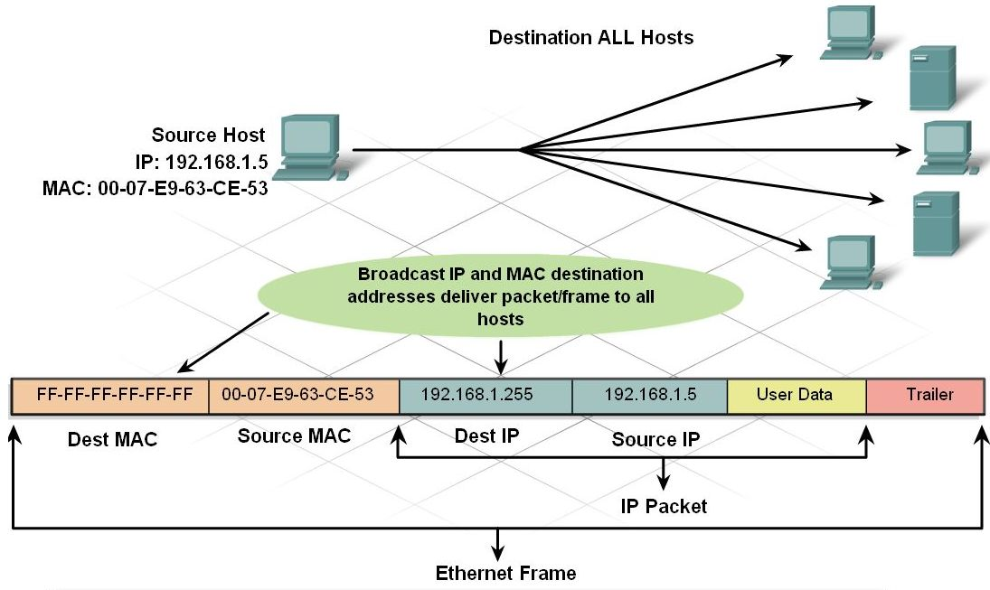
Types of IP Addresses
Differentiate between Unicast, Broadcast, Multicast Addresses

Slide 11
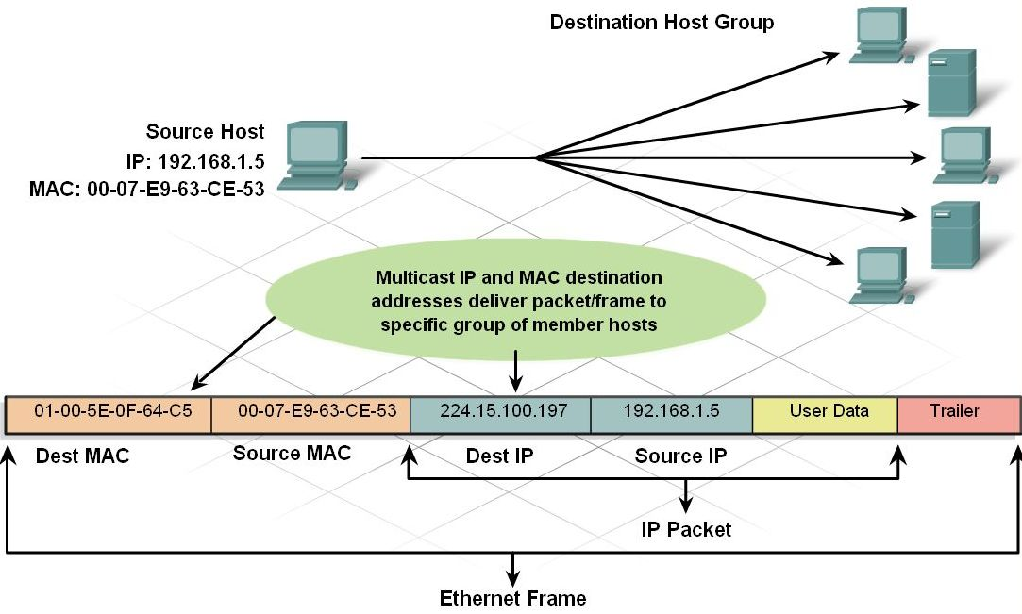
Types of IP Addresses
Differentiate between Unicast, Broadcast, Multicast Addresses

Slide 12
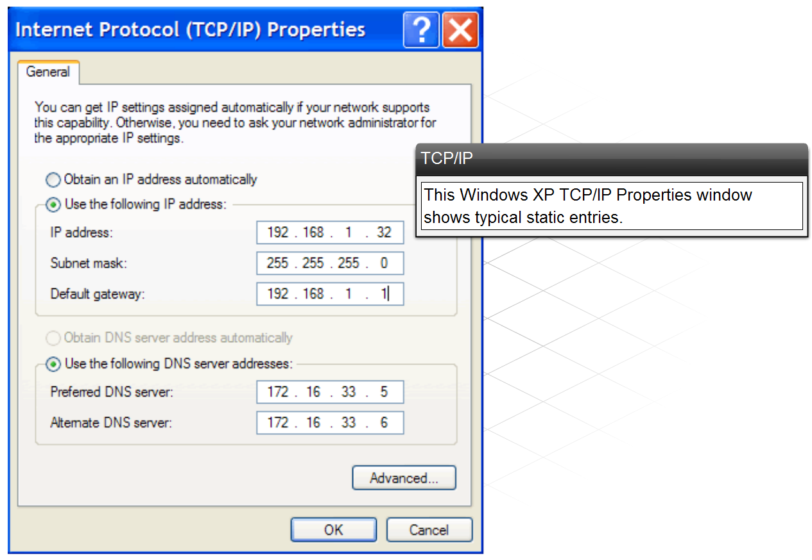
Methods of Obtaining an IP Address
Review the methods of assigning an IP Address
  Static Assignment
  Dynamic Assignment

Slide 13
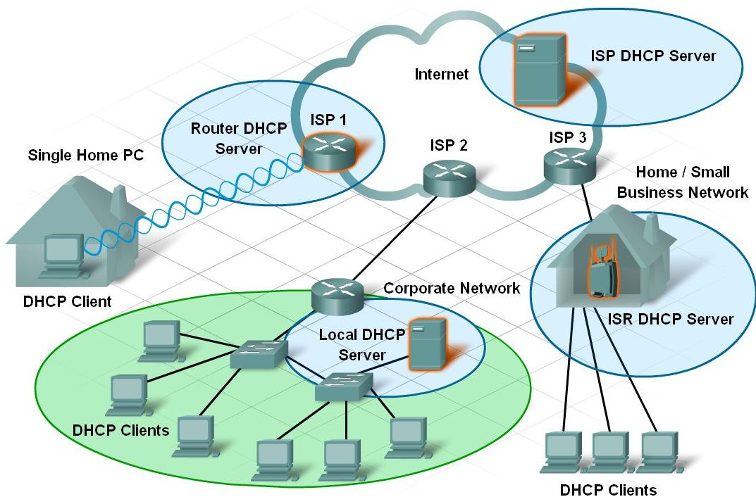
Methods of Obtaining an IP Address
Describe where the DHCP services are located

Slide 14
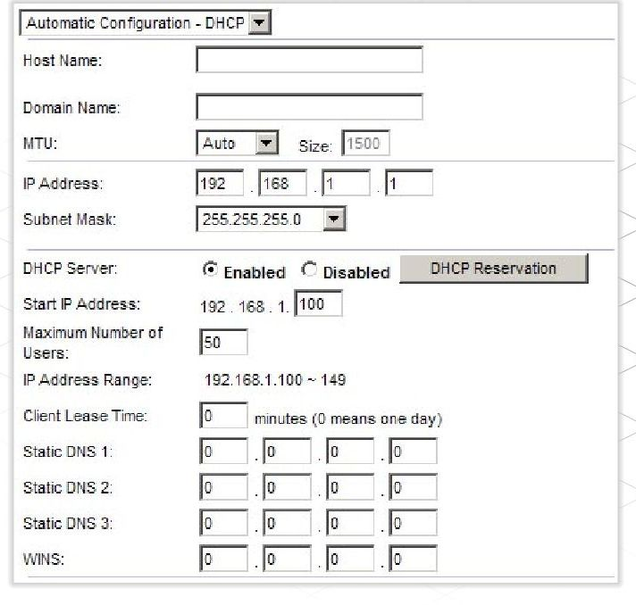
Methods of Obtaining an IP Address
Configure and verify DHCP range on the GUI-based home-integrated router

Slide 15
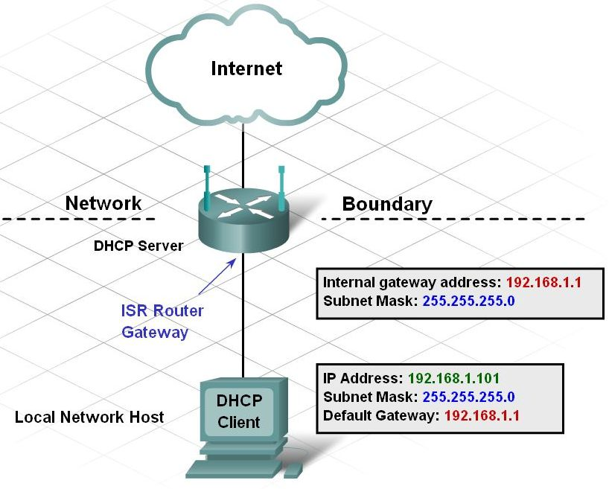
Using DHCP with a Home or Small Business Network
Describe the boundaries of a network as it relates to address space
Discuss Gateways

Slide 16
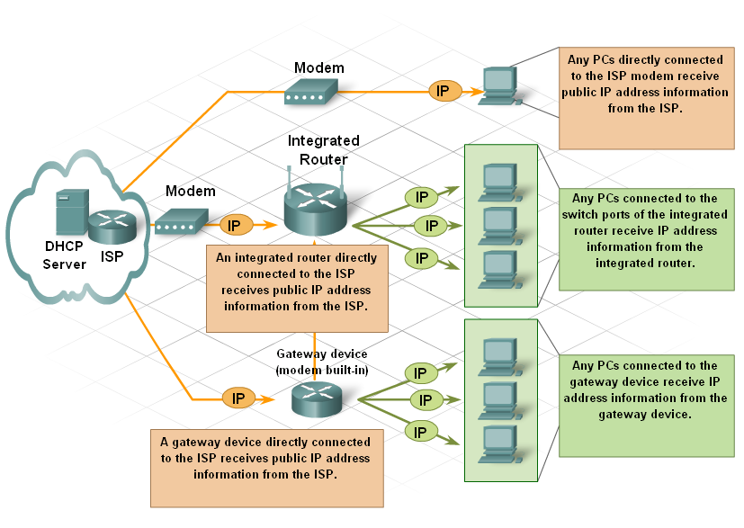
Address Management
Describe addresses assigned by the ISP vs. assigned by the integrated router

Slide 17
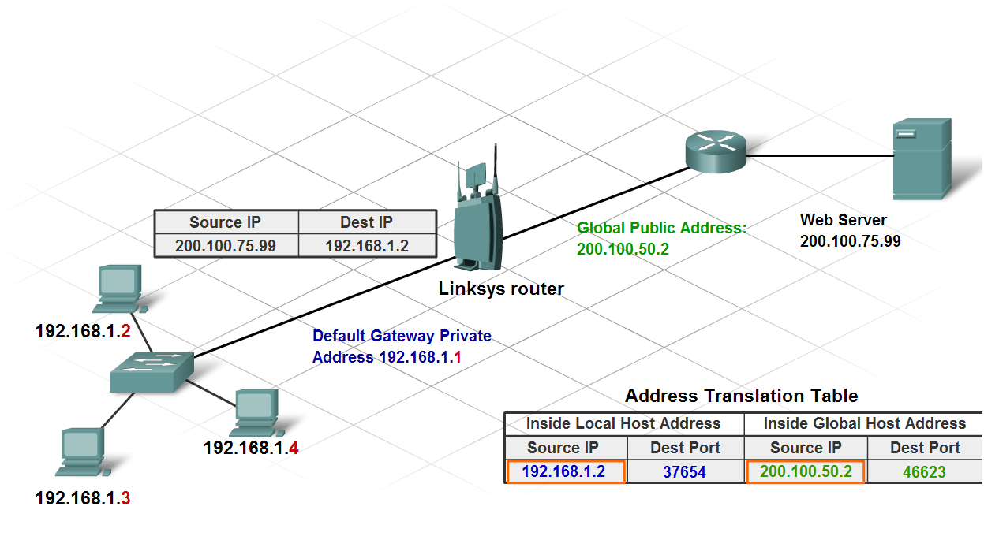
Using NAT with a Home or Small Business Network
Describe the use of NAT on a home or small business network using an integrated router

Slide 18
Summary
IP addresses are unique 32-bit addresses grouped into four 8-bit bytes called octets.
IP addresses use a two-part hierarchical structure of network bits and host bits.
IP addresses and subnet masks are used by routers to determine the network location of hosts.
IP addresses are grouped into classes according to the number of bits used for designating the network, and further divided into public and private ranges.
Private IP addresses must be translated to public IP addresses in order to move through the Internet.
IP addresses can be assigned statically or dynamically.

